Slide 1
INTRODUCTION TO COMPUTING
Course Code: CCINCOM/L
Introduction to Analysis of Algorithms
Elizer Ponio Jr.
Faculty
Department of Computer Science
College of Computing and Information Technologies (CCIT)
National University
Joseph Marvin R. Imperial
ALGORITHMS AND COMPLEXITY
NU College of Computing and Information Technologies
Course Code: ALGOCOM

Slide 2
Difference between Algorithms and Programs
Algorithms | Program
Design Phase | Implementation Phase
Person with Domain Knowledge | Programmer
Any Language | Programming Language
Hardware and Software independent | Hardware and Software dependent
Analysis | Testing
ALGORITHMS AND COMPLEXITY
Course Code: CCALCOMP
Notes:
Explain the difference between an algorithm and a program

Slide 3

Characteristics of an Algorithm
Input
Output
Definiteness/Solvable
Finiteness
Effectiveness
ALGORITHMS AND COMPLEXITY
Course Code: CCALCOMP
Notes:
Not all algorithms need an input
Algorithms are required to have some output
Each step in an algorithm should be solvable
Algorithms should start and end at some point
Algorithms should not contain unnecessary steps

Slide 4
How to Analyze an Algorithm
Time
Space
Scalability
Power Consumption
ALGORITHMS AND COMPLEXITY
Course Code: CCALCOMP

Slide 5
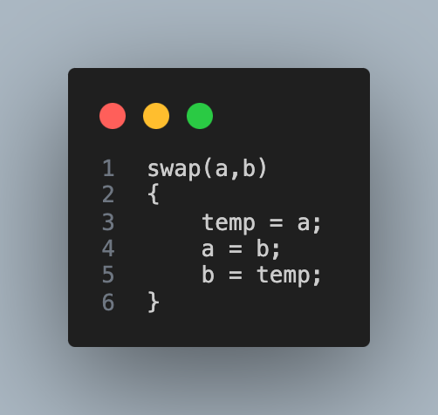
ALGORITHMS AND COMPLEXITY
Course Code: CCALCOMP

